Slide 1
NIFTY 500 Market Performance Analysis Using Power BI
HISTORICAL AnalySIS OF NIFTY 500 (2000-2025)
PrePARed by- Dipanjan Pramanik (AF05201379)
Notes:
Title Page

Slide 2
Today’s Presentation
Introduction
Project Objective
Dashboard Overview
Data Cleaning
Calendar Table
Data Modeling
DAX Measures
Dashboard Overview
KPI Cards
Chart Analysis
Key Business Insights
Conclusion
Future Scope
Notes:
Agenda

Slide 3
About NIFTY 500
What is NIFTY 500 ?
NIFTY 500 is one of the major stock market indices in India.
It contains the top 500 companies listed on the National Stock Exchange (NSE).
It represents almost the entire Indian equity market.
Investors use it to understand the overall performance of the Indian Stock Market.
Why did I choose this project ?
Real financial dataset.
Large historical dataset.
Suitable for Power BI.
Demonstrates analytical skills.
Notes:
About NIFTY 500

Slide 4
Project Objective
Objective
The main objective of this project is to transform raw historical stock market data into an interactive dashboard that helps users analyze market performance.
Goals
Analyze market trends.
Compare Year-wise performance.
Compare Month-wise performance.
Study trading activity.
Build an interactive dashboard.
Notes:
Project Objective

Slide 5
Dataset Overview
Source – National Stock Exchange
Duration – 2000-2025
Files – 25 CSV Files
Columns Used -
Column Description
Date Trading Date
Open Opening Price
High Highest Price
Low Lowest Price
Close Closing Price
Shares Traded Trading Volume
Turnover Total Trading Value
Notes:
Project Objective

Slide 6
Data Cleaning (Power Query)
Data Cleaning
Performed using Power Query
Why did I clean the Data ?
I cleaned the data to ensure accurate analysis, improve dashboard performance, and create reliable visualizations in Power BI.
Steps
Imported 25 CSV files
Combined into one dataset
Removed errors
Checked missing values
Converted data types
Renamed columns
Notes:
Data Preparation

Slide 7
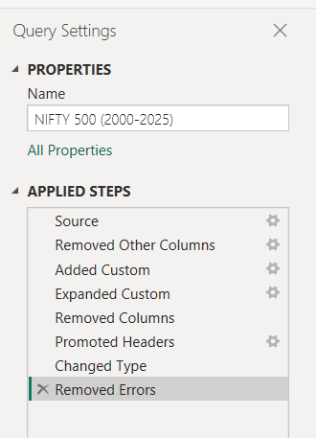
Applied steps in Power Query

Slide 8
Why Create a Calendar Table?
Why did I create a Calendar Table ?
A Calendar table helps organize dates for efficient tie-based analysis and follows Power BI best practices.
Created Columns
Date
Year
Month
Month Number
Quarter
Benefits
Easy filtering
Better time analysis
Professional data model
Better DAX calculations
Notes:
Calendar Table

Slide 9
Data Modeling
This project follows a Star Schema
Calendar
│
▼
Nifty500
Relationship
One-to-Many
Single Cross Filter Direction
Active Relationship
Why did I use Star Schema ?
Star Schema organizes data efficiently, improves report performance, and makes filtering and time-based analysis easier in Power BI.
Notes:
Data Modeling

Slide 10
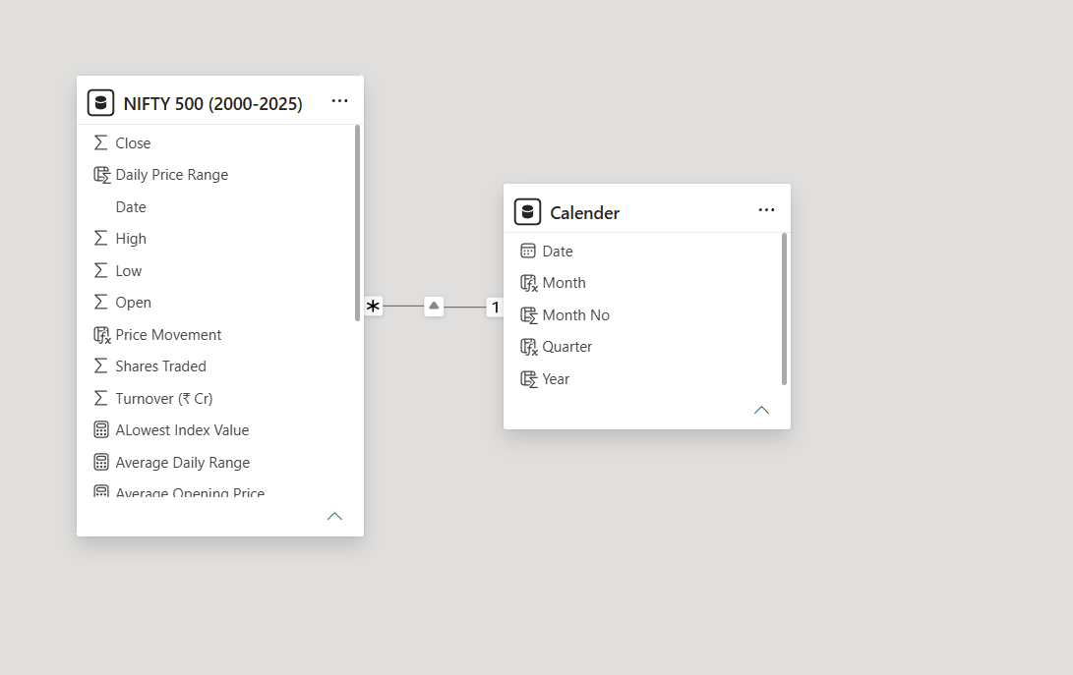
Data Modeling

Slide 11
DAX Measures
Measure
Highest Close
Lowest Close
Average Close
Total Turnover
Total Shares Traded
Dashboard Title
Formula
MAX()
MIN()
AVERAGE()
SUM()
SUM()
Dynamic Title

Slide 12
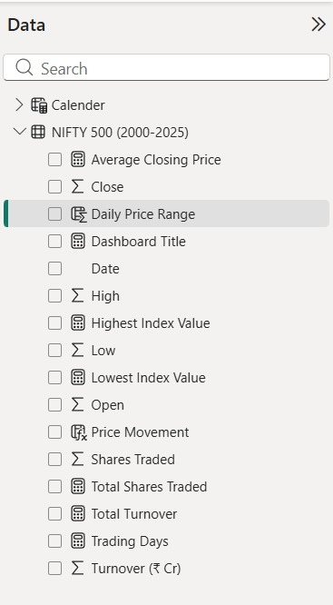
DAX Measures

Slide 13
Dashboard Overview
Dashboard contains
KPI Cards
Slicers
Charts
Interactive Filtering
Dynamic Title
Notes:
Dashboard Overview

Slide 14
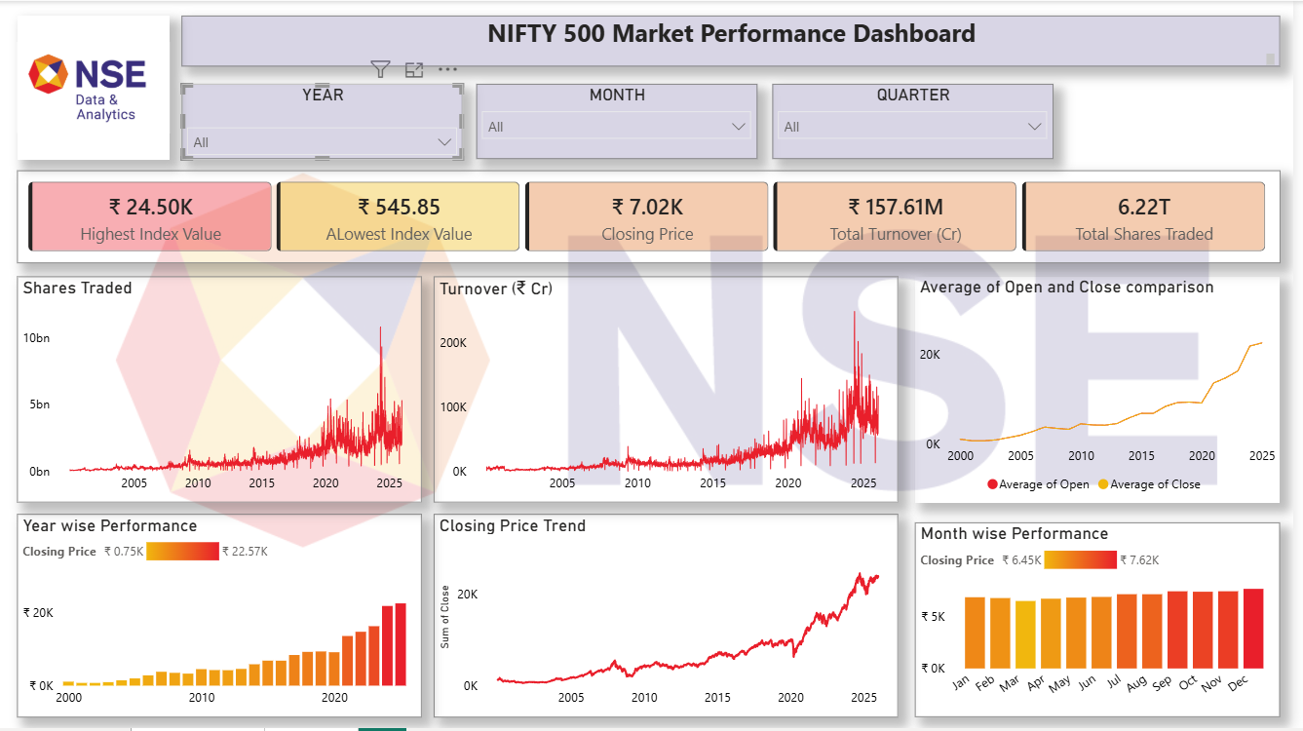
Dashboard Overview

Slide 15
Dashboard Features
Dynamic Title
Changes automatically based on
Year
Month
Quarter
Slicers
Year
Month
Quarter
Why ?
Slicers allow users to interactively filter the dashboard without changing the original data.
Notes:
Dashboard Features

Slide 16
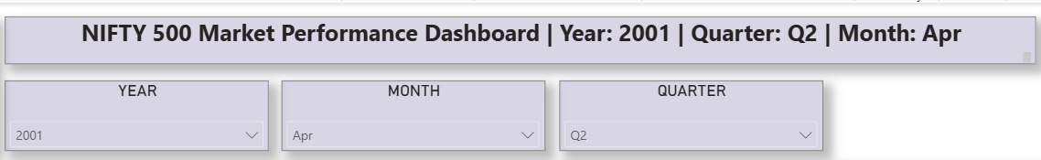
Dashboard Features

Slide 17
KPI Cards
Highest Close
Shows the maximum closing price.
Identify the highest market level.
Lowest Close
Shows the minimum closing price.
Identify market downturns.
Average Closing Price
Shows the average market level.
Understand long-term market behaviour.
Total Turnover
Shows total value traded.
Measure market liquidity.
Total Shares Traded
Shows overall trading activity.
Understand market participation.
Notes:
KPI Cards

Slide 18
KPI Cards

Slide 19
Chart Analysis
Shares Traded Trend
Why Line Chart ?
A line chart is best for showing changes over time.
What does it show ?
Shows how trading activity changed over the years.
Business Insight
Higher trading volume generally indicates greater investor participation.
Turnover Trend
Why Line Chart ?
Shows how total trading value changes over time.
Business Insight
Increasing turnover suggests increased market activity and liquidity.

Slide 20
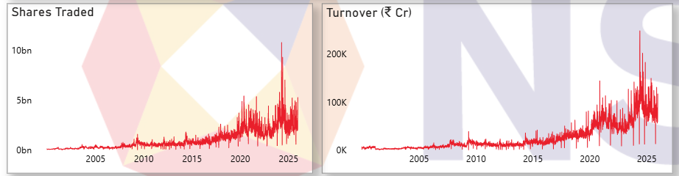
Chart Analysis

Slide 21
Chart Analysis
Monthly Average Opening vs Closing Price
Why Line Chart?
A line chart clearly compares two related measures over time.
Measures Used
Average Opening Price
Average Closing Price
What does it show?
Compares the average opening and closing prices for each month.
Business Insight
Helps identify whether the market generally closed above or below its opening value during different months.
Month-wise Performance
Why Column Chart?
Column charts make comparisons between categories easier.
Business Insight
Shows seasonal changes in average closing prices across months.

Slide 22
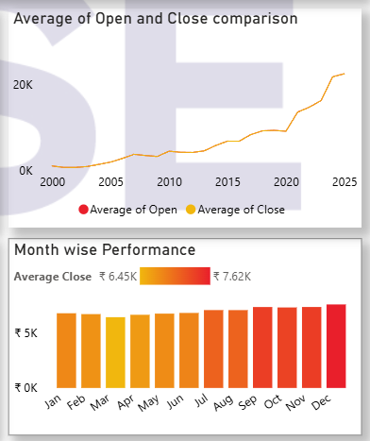
Chart Analysis

Slide 23
Chart Analysis
Closing Price Trend
Why Line Chart?
Shows long-term trends effectively.
Business Insight
Illustrates the long-term growth of the NIFTY 500 over the years.
Year-wise Performance
Why Column Chart?
Compares yearly average closing prices.
Business Insight
Highlights which years experienced stronger market performance.

Slide 24
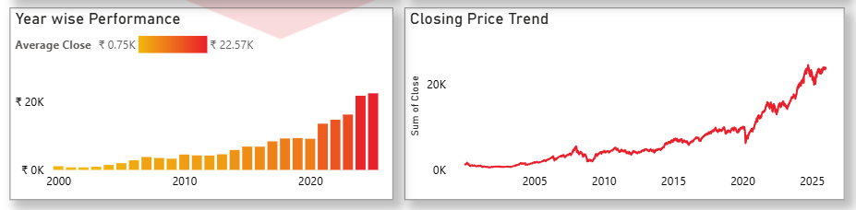
Chart Analysis

Slide 25
Key Business Insights
The NIFTY 500 shows a strong long-term upward trend.
Trading volume increased significantly after 2020.
Turnover also increased, indicating higher market participation.
Average closing prices generally rose over time.
Interactive filters allow easy comparison across years, quarters, and months.

Slide 26
Conclusion
This project demonstrates the complete Power BI workflow:
Data Import
Data Cleaning
Data Modeling
Calendar Table
DAX
Dashboard Design
Business Analysis
Skills Learned
Power Query
DAX
Data Modeling
Power BI Visualization
Dashboard Design
Business Storytelling

Slide 27
Future Scope
Possible improvements:
Add live NSE API data.
Add moving averages and other technical indicators.
Create drill-through pages.
Add forecast visuals.
Compare NIFTY 500 with other indices such as NIFTY 50 or Sensex.
Add mobile-friendly dashboard layout.

Slide 28
References
Data Source
National Stock Exchange (NSE) – Historical NIFTY 500 Data (2000–2024)
Tools Used
Microsoft Power BI Desktop
Power Query
DAX
ChatGPT (for making dynamic dashboard title)
Courtesy
Historical market data provided by the National Stock Exchange (NSE). This dashboard was developed for educational and portfolio purposes only.

Slide 29
Thank You

